Slide 1
Laravel
Authentication
Middleware
PHP WebDevelopment 2019
Milena Tomova
Vratsa Software
https://vratsasoftware.com/

Slide 2
Table of Contents
Frontend Scaffolding
Authentication
Middleware

Slide 3



Learn to Search in Internet
The course assignments require to search in Internet
This is an important part of the learning process
Some exercises intentionally have no hints
Learn to find solutions!
Software development includes everyday searching and learning
No excuses, just learn to study!
Developers learn new technologies, tools, languages every day!

Slide 4
Frontend Scaffolding

Slide 5
Frontend Scaffolding
Frontend Scaffolding
While Laravel does not dictate which JavaScript or CSS pre-processors you use,
it does provide a basic starting point using Bootstrap, React, and / or Vue that will be helpful for many applications.

Slide 6
Frontend Scaffolding
The Bootstrap and Vue are located in the laravel/ui Composer package
which may be installed by
composer require laravel/ui:^2.4

Slide 7
Frontend Scaffolding
then you may install the frontend scaffolding of your choice using the ui Artisan command
run npm install and npm run dev
// Generate basic scaffolding...
php artisan ui bootstrap
php artisan ui vue
php artisan ui react

Slide 8
Frontend Scaffolding
to generate Laravel Auth scaffolding
// Generate login / registration scaffolding...
php artisan ui bootstrap --auth
php artisan ui vue --auth
php artisan ui react --auth

Slide 9
Authentication

Slide 10
Authentication
Authentication
Laravel makes implementing authentication very simple.
In fact, almost everything is configured for you out of the box.
The authentication configuration file is located at config/auth.php, which contains several well documented options for tweaking the behavior of the authentication services.

Slide 11
Authentication
to generate Laravel Auth scaffolding
// Generate login / registration scaffolding...
php artisan ui bootstrap --auth
php artisan ui vue --auth
php artisan ui react --auth

Slide 12
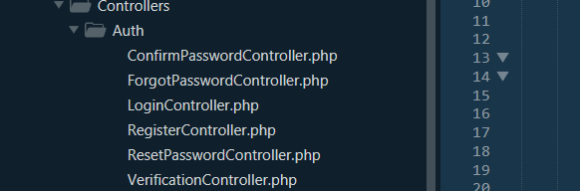

Authentication
This command creates -
auth routes
auth controllers

Slide 13
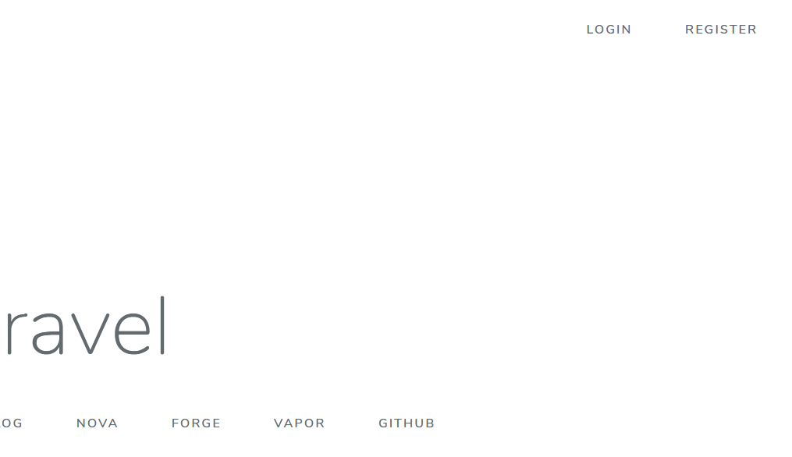
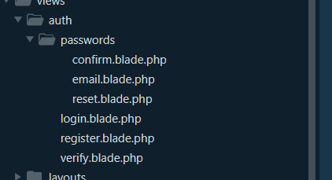
Authentication
auth views - backend
frontend

Slide 14
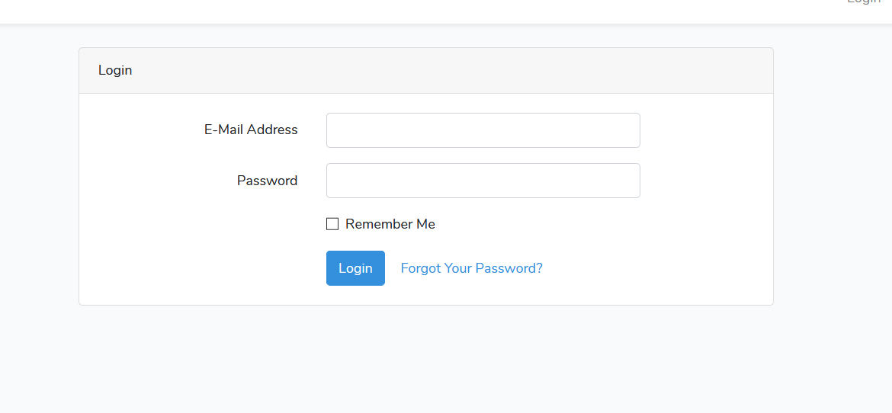
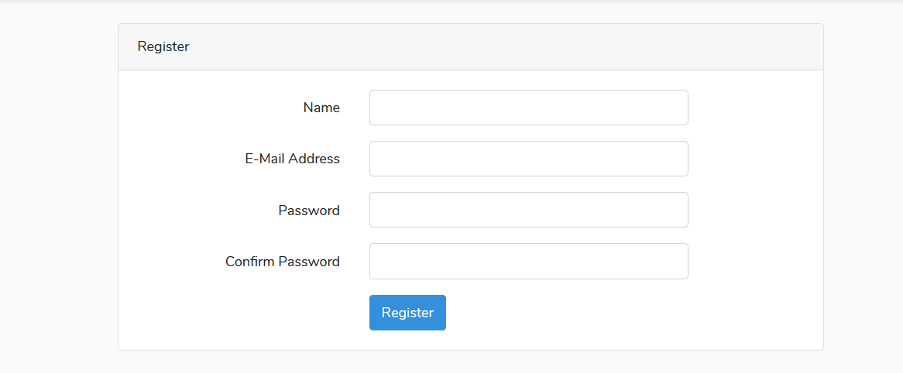
Authentication
frontend auth views

Slide 15
Authentication
Authentication
The auth system is fully customisable.
You can change -
the user login/registration
auth driver
design
auth customisations

Slide 16
Customising auth logic flow
If you need to change customisation logic
you do not change the methods in AuthenticatesUsers trait.
You redefine auth properties and methods in the appropriate controllers as shown in the documentation

Slide 17
Authentication
Authentication
Retrieving the authenticated user
You may access the authenticated user via the Auth facade - always place on top of the file, holding the class definition -
use Illuminate\Support\Facades\Auth;

Slide 18
Authentication
in the controller or model -
// Get the currently authenticated user...
$user = Auth::user();
// Get the currently authenticated user's ID...
$id = Auth::id();

Slide 19
Authentication
Once a user is authenticated, you may access the authenticated user
via an Illuminate\Http\Request instance.
Remember, type-hinted classes will automatically be injected into your controller methods:
public function update(Request $request)
{
// $request->user() returns an instance of the authenticated user...
}

Slide 20
Authentication
To determine if the user is already logged into your application -
if( Auth::check() ) {
// The user is logged in…
}

Slide 21
Determining If The Current User Is Authenticated
Even though it is possible to determine if a user is authenticated using the check method,
you will typically use a middleware
to verify that the user is authenticated
before allowing
the user access to certain routes / controllers.

Slide 22
Auth Middleware
To allow only authenticated users to access a given route.
Route::get('profile', function () {
// Only authenticated users may enter...
})->middleware('auth');

Slide 23
Auth Middleware
Protect all controller methods by calling a middleware in controller`s constructor
public function __construct()
{
$this->middleware('auth');
}

Slide 24
Auth Middleware
Laravel ships with an auth middleware,
which is defined at Illuminate\Auth\Middleware\Authenticate.
Since this middleware is already registered in your HTTP kernel, all you need to do is attach the middleware to a route definition(s)

Slide 25
Auth Middleware
Redirect unauthenticated users to named route
modify this behavior by updating the redirectTo function in your app/Http/Middleware/Authenticate.php file
protected function redirectTo($request)
{
return route('login');
}

Slide 26
Authentication
Authentication
For more on Laravel authentication, please read the documentation

Slide 27
Middleware

Slide 28
Middleware
Middleware
Middleware provide a convenient mechanism for filtering HTTP requests entering your application - for protecting the routes of the application.
For example, Laravel includes a middleware that verifies the user of your application is authenticated.
If the user is not authenticated, the middleware will redirect the user to the login screen.
However, if the user is authenticated, the middleware will allow the request to proceed further into the application. documentation

Slide 29
Middleware
Middleware
Additional middleware can be written to perform a variety of tasks besides authentication.
Let`s build a middleware that will protect
the admin routes - the routes for reading, adding, editing, deleting users.

Slide 30
Middleware
create a new middleware
This command will place a new CheckIsAdmin class
within your app/Http/Middleware directory.
php artisan make:middleware CheckIsAdmin

Slide 31
Middleware
In this middleware, we will only allow access to the route if the user role is admin. Otherwise, we will redirect the users back to the home URI.
public function handle($request, Closure $next)
{
if ($request->user()->role->name != ‘admin’) {
return redirect('home');
}
return $next($request);
}

Slide 32
Middleware
The middleware runs before the request is handled by the app
public function handle($request, Closure $next)
{
if ($request->user()->role->name != ‘admin’) {
return redirect('home');
}
return $next($request);
}

Slide 33
Middleware
The middleware runs after the request is handled by the app
public function handle($request, Closure $next)
{
$response = $next($request);
// Perform middleware check action
return $response;
}

Slide 34
Middleware
Register the middleware in app/Http/Kernel.php if you want to run during every HTTP request to your application in the $middleware property.
If you want to assign the middleware to specific routes - follow the steps in the documentation.

Slide 35
Middleware
To assign multiple middlewares -
See the documentation for available ways of grouping routes.
Route::resource('/demo', 'demoController')->middleware(['auth', 'admin']);

Slide 38



Trainings @ Vratsa Software
Vratsa Software – High-Quality Education, Profession and Jobs
www.vratsasoftware.com
The Nest Coworking
www.gnezdoto.vratsasoftware.com
Vratsa Software @ Facebook
www.fb.com/VratsaSoftware
Slack Channel
www.vso.slack.com

